Slide 1


Financial Risk Detection
Submitted by
V.S.Srimathi

Slide 2


CONTENT
Problem Statement
Tools used
Approaches
EDA
Model Build and Evaluation
Conclusion

Slide 3
Problem Statement
This case study aims to identify patterns which indicate if a client has difficulty paying their instalments which may be used for taking actions such as denying the loan, reducing the amount of loan, lending (to risky applicants) at a higher interest rate, etc. This will ensure that the consumers capable of repaying the loan are not rejected. Identification of such applicants using EDA is the aim of this case study. In other words, the company wants to understand the driving factors (or driver variables) behind loan default, i.e. the variables which are strong indicators of default. The company can utilise this knowledge for its portfolio and risk assessment.

Slide 4
Tools
Programming Languages:
Python: Widely used for its extensive libraries and frameworks, including TensorFlow, PyTorch, scikit-learn, and more.
Data Processing and Analysis:
NumPy: Essential for numerical computing in Python, providing support for large, multi-dimensional arrays and matrices.
pandas: A data manipulation and analysis library for Python, commonly used for handling structured data.
Visualization:
Matplotlib: A plotting library for creating static, animated, and interactive visualizations in Python.
Seaborn: Built on top of Matplotlib, Seaborn provides a high-level interface for drawing attractive statistical graphics.

Slide 5
Jupyter Notebooks:
Interactive notebooks that allow combining live code, equations, visualizations, and narrative text. Popular for data exploration and analysis.
Version Control:
Git: Widely used for version control and collaborative development of machine learning projects.

Slide 6
Approaches
Define Business case/Problem Statement
Import basic Libraries
Load Data
Domain Analysis
Basic Checks
Exploratory Data Analysis
Check for Outliers
Handling Outliers
Feature Engineering
Balancing the data by using smote
Split Data into X and Y
Split data for testing and training
Model Building
Evaluate the Model

Slide 7
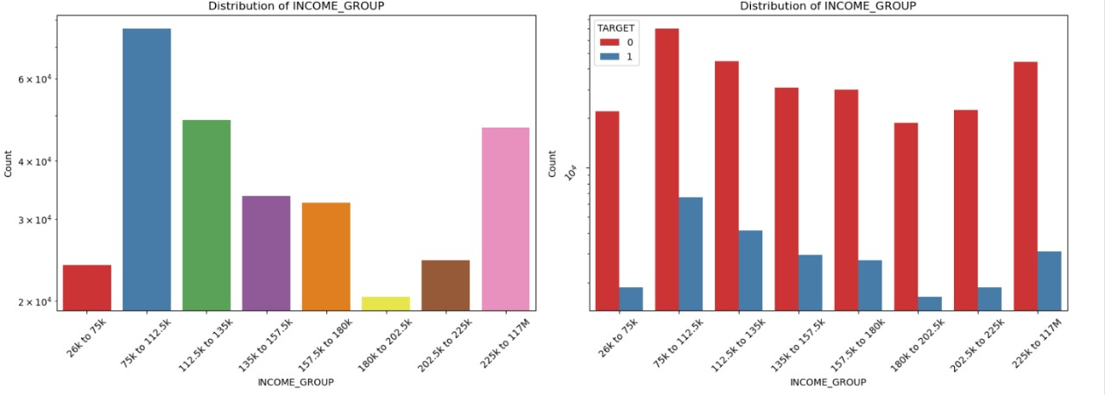
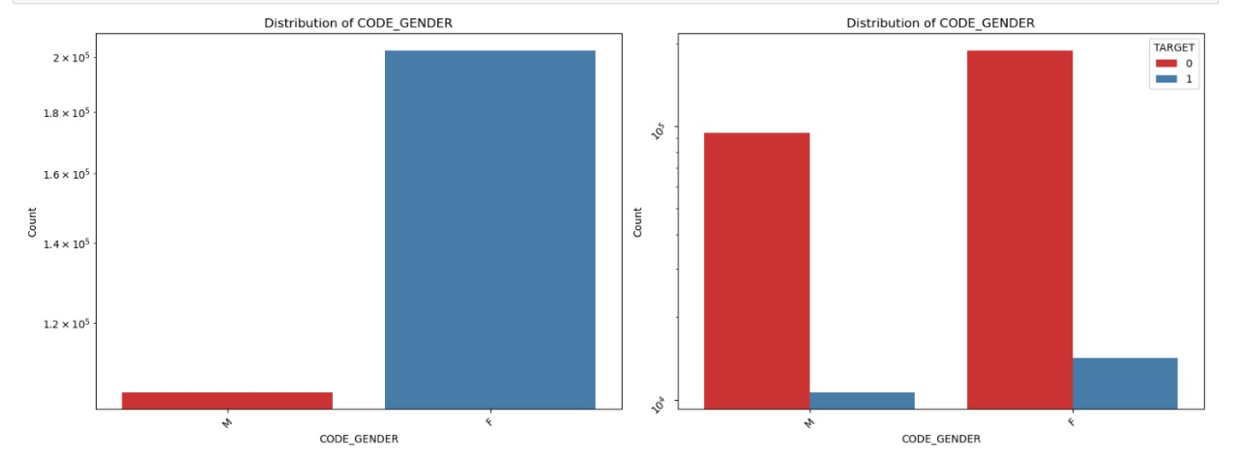
EDA
AMT Income Total
It appears that a majority of people in our dataset have incomes between 75k and 112k and highest numbers of defaulters also fall within this income range. This observation suggest a potential correlation between income levels and loan default rates.
Code Gender
This suggest that there are more female applicants seeking loans

Slide 8
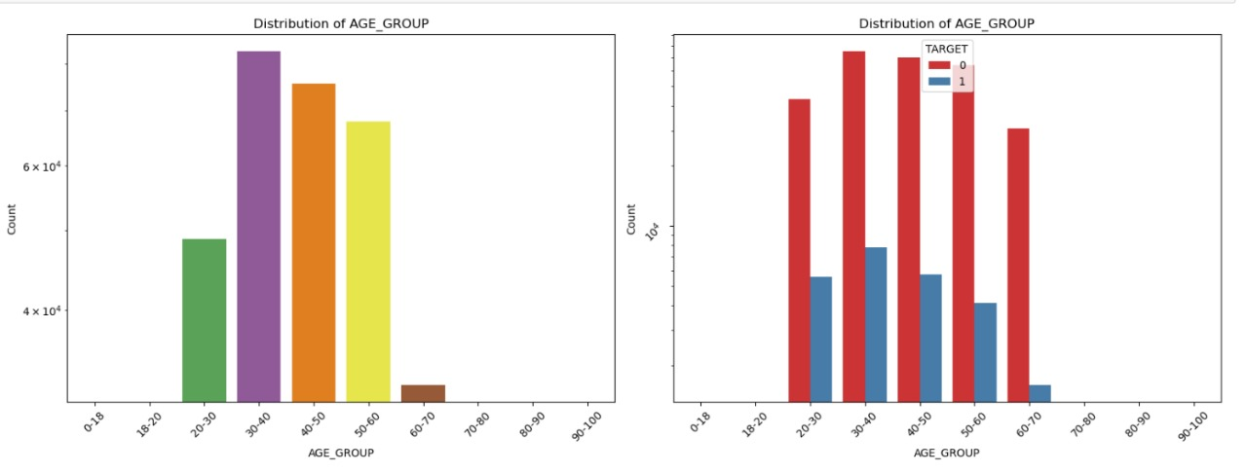
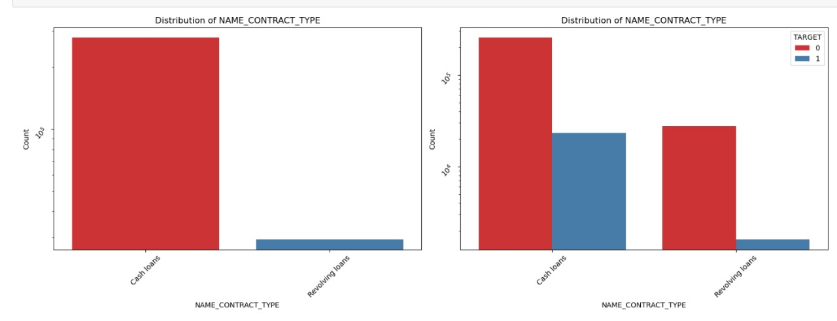
Age
The majority of loan applicants fall within the age range of 30-40, indicating concentration of individuals in this demographic
Name Contract Type
The observation holds true for both defaulters and non-defaulters, indicating a consistent trend across the client
Population.

Slide 9
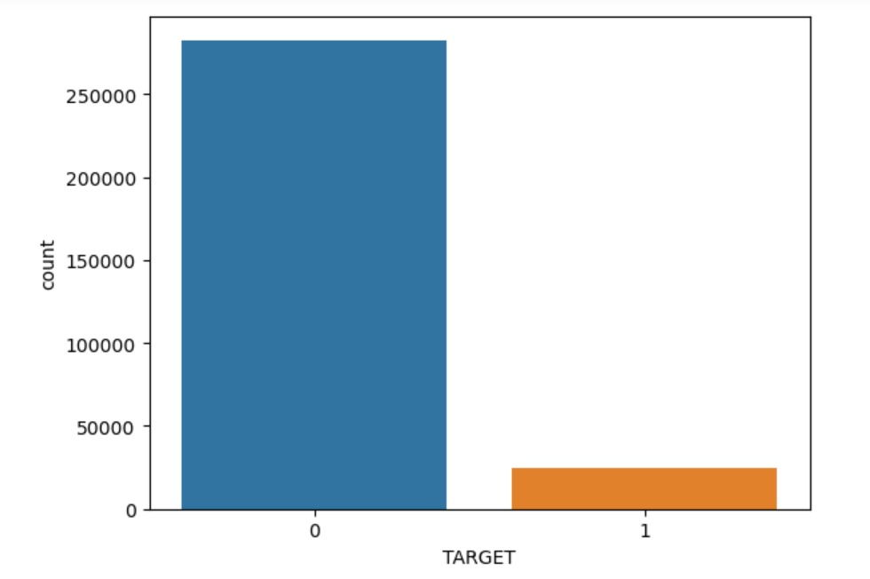
Target
1 typically represents customers who are classified as “high risk” or those who at higher risk of getting loan default
0 typically represents customers who are classified as “low risk” or those who have a lower risk of defaulting

Slide 10
Model Building
Split the data for train and test
Initialise model
Train model with X_Train and Y_Train
Make prediction / Test Model
We have to compare Y_Prediction & Y_Test
Evaluate the Model
Classification ( Target is Binary)
Using Matrics to evaluate classification algorithms
Confusion Matrix

Slide 11
Conclusion
Banks should focus more on contract type ‘Student’, ‘pensioner’, ‘Businessman’ with housing type other than Co-op apartment for successful payments.
Banks should focus less on income type ‘Working’ as they are having most number of unsuccessful payments.
Also with loan purpose ‘Repair’ is having higher number of unsuccessful payments on time.
Get as much as clients from housing type ‘With Parents’ as they are having least number of unsuccessful payments.

Slide 12
We observe a decrease in the percentage of Payment difficulties who are Pentioners and an increase in the percentage of payment difficulties who are working when compared the percentages of both payment difficulties and non-payment difficulties.
We observe a decrease in the percentage of married and widowed with loan payment difficulties and an increase in the percentage of single and civil married with loan payment difficulties when compared with the percentage of both loan payment difficulties and loan Non-Payment difficulties.
Key Factors of Successful Repayments
Education Matters: Applications holding academic degrees exhibit a significantly lower default rate.
Income Diversity: Individuals in various income-generating roles, such as students and businessmen, demonstrate a strong repayment record.
Age Advantage: Loan applicants above the age of 50 exhibit a lower tendency to default

